Slide 1
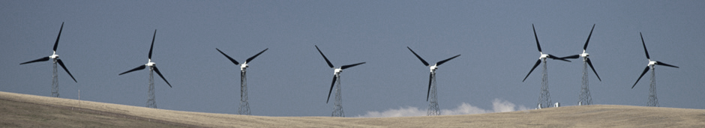
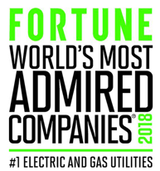


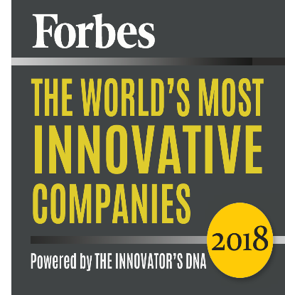
11 times World’s Most Ethical Company
3 times America's Best Employers
Top
20
in the world for Innovation
# 1 among Electric & Gas utilities

